Slide 1

BODY FITNESS PREDICTION
EXTERNSHIP PROJECT
Presented by:
Sura Laya (18UK1A05K7)
Komandla Sushmitha (18UK1A05K5)
Mohammed Azharuddin (18UK1A05J1)
Poshala Sai Deepak (18UK1A05L6)
Nagavelli Manish Kumar (19UK5A0528)
Presented to:
Pradeepthi Raju (Mentor)

Slide 2
INTRODUCTION:
Sedentary lifestyle is defined by the absence of physical activity practices throughout the day and causes a decrease in caloric expenditure. This behavior is explained by the inappropriate lifestyle, for example, too much time sitting or lying down and still eating unhealthy foods during this time of immobilization. Currently, a third of the adult world population is physically inactive and this generates 5 million deaths per year (The Lancet, 2012). In addition to contributing to several chronic diseases, physical inactivity also influences mood, sleep quality and body weight.

Slide 3
ABSTRACT :
Body fitness prediction play’s a key role in leading a healthy life. Fitness is a state of health and well-being, more specifically the ability to perform daily activities body fitness is generally achieved through proper nutrition and physical exercise and resting. People are spending more and more time doing sedentary activities. During our leisure time, we are often sitting using computer or other device. By this we are losing our body fitness and it leads to various chronic issues like breathing problems,obesity etc..

Slide 4
PURPOSE :
To avoid this health issues, we should monitor our body fitness by using various fitness prediction gadgets like smart watches, oximeter, B-P machine etc. we can monitor our B-P, calories burnt, bone weight etc. the devices work with smart device technology to exchange data via Bluetooth communication protocol. Here, in this project we import the data which consist of (date, step-count, mood, calories burned, hours of sleep, bool of active, weight in kg) split the dataset into testing set and training set. We are using Random Forest Classifier in this project.

Slide 5
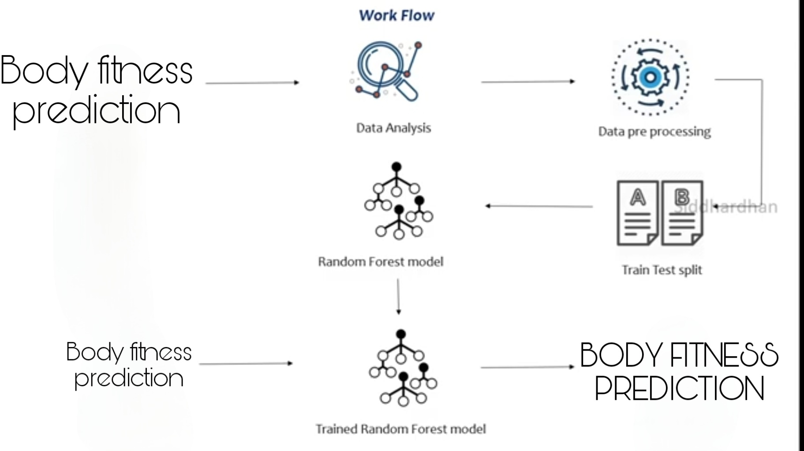
WORK FLOW

Slide 6
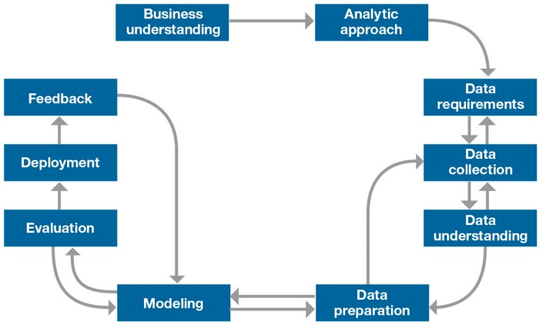
METHODOLOGY

Slide 7
TOOLS AND TECHNOLOGIES :
Importing Libraries
#importing libraries
import pandas as pd
import numpy as np
#standard visualization libraries
import matplotlib.pyplot as plt %matplotlib inline
import seaborn as sns
Importing Dataset
Exploratory Data Analysis

Slide 8
DATA ANALYSIS :
Data Visualization:
It is an approach of analyzing datasets to summarize their main characteristics
Pair plot:
It plots a pairwise relationship in the dataset.
Scatter plot:
This plot displays the relationship between any two sets of data.
Correlation plot:
The correlation plot shows the correlation coefficient between variables.
Box plot:
We plot the outlier that is present inside the dataset.

Slide 9
TRAINING AND TESTING:
Splitting the data:
We use the sklearn.ensemble module train_test_split which is used for training and testing part.
Dependent and Independent variables:
Independent variables contain a list of variables in which bool of active is dependent.
Dependent variable is the variable that is dependent on the other variables values.
Independent variables are mood,step_count,calories burned,hours of sleep,weightkg.
Dependent variables are bool_of_active.
MODEL BUILDING:
We use Random Forest Classifier for predicting Body Fitness Prediction. Because it gives accurate prediction .

Slide 10
CONCLUSION
Saving the model :
We save our machine learning model using pickle.
Deployment using Flask:
In the end we want our model to be available for the end users. So that the end user can use our model. Model deployment is one of the last stage in any machine learning project.

Slide 11
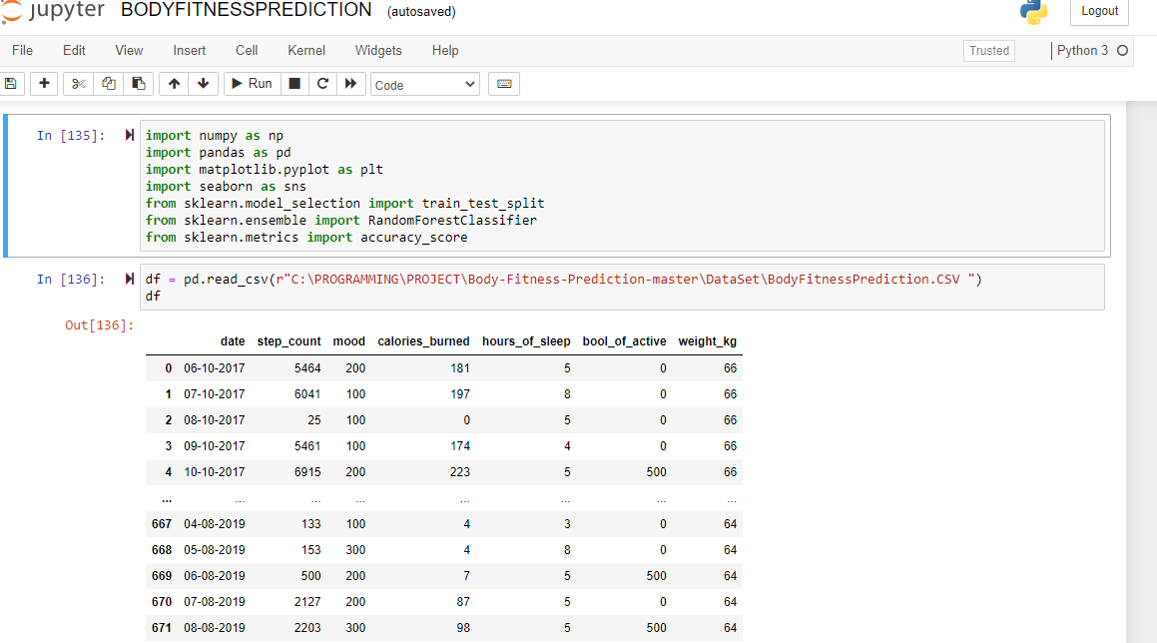
PROJECT SCREENSHOTS

Slide 12
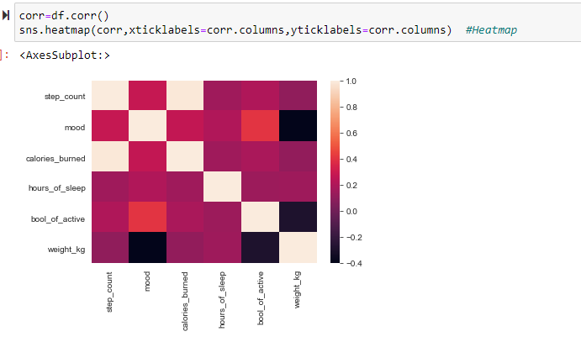

Slide 13
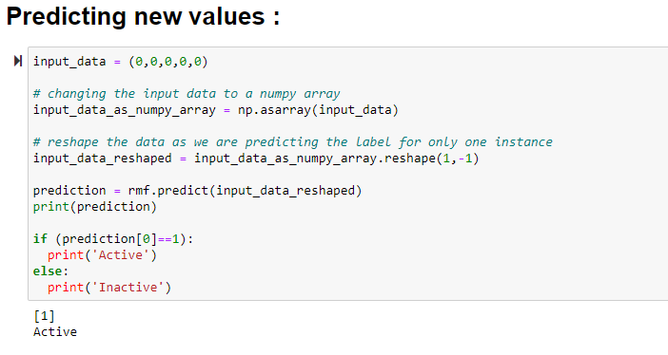

Slide 14
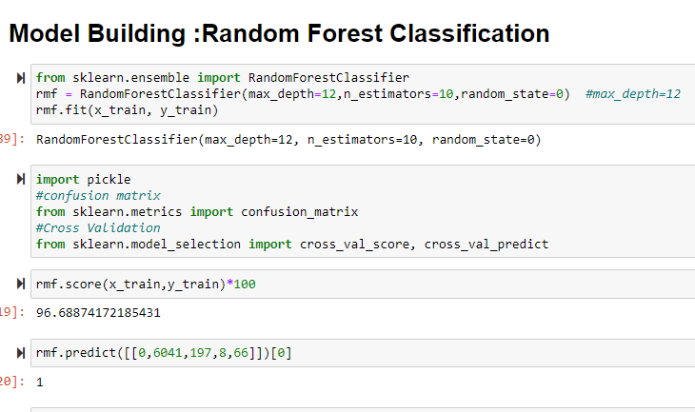

Slide 15
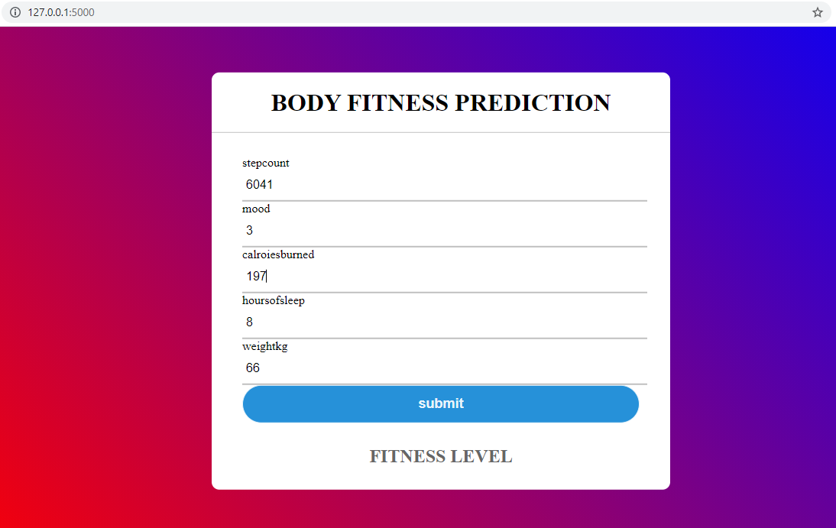

Slide 16
THANK YOU

